Slide 1
S3(Simple Storage Service)

Slide 2
Create S3 Bucket
Sign in to the AWS console and open Amazon S3 console Under Storage.
Chose create bucket, Enter details.
The bucket name must:
Be unique across all s3.
Be between 3 to 63 characters long.
Not contain uppercase characters.
Start with lowercase or number.
Chose AWS region where we want the Bucket to reside.
By default Amazon S3 blocks all public access to our buckets.
Make it Bucket as public.(As shown below picture).

Slide 3
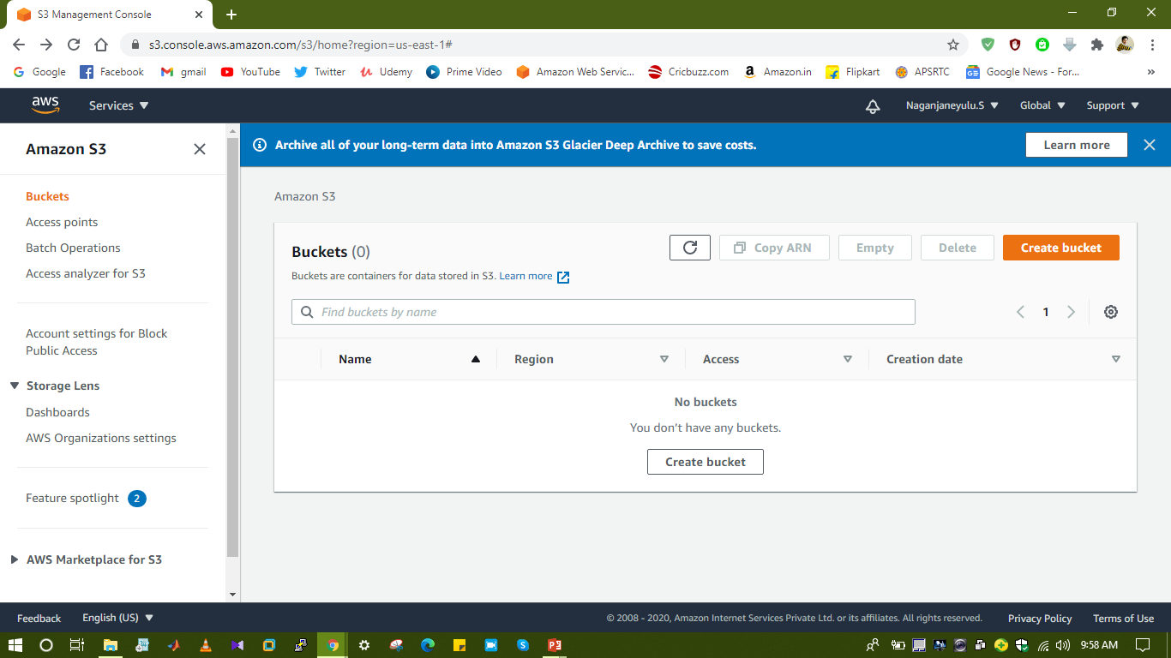
Amazon S3 Dashboard

Slide 4
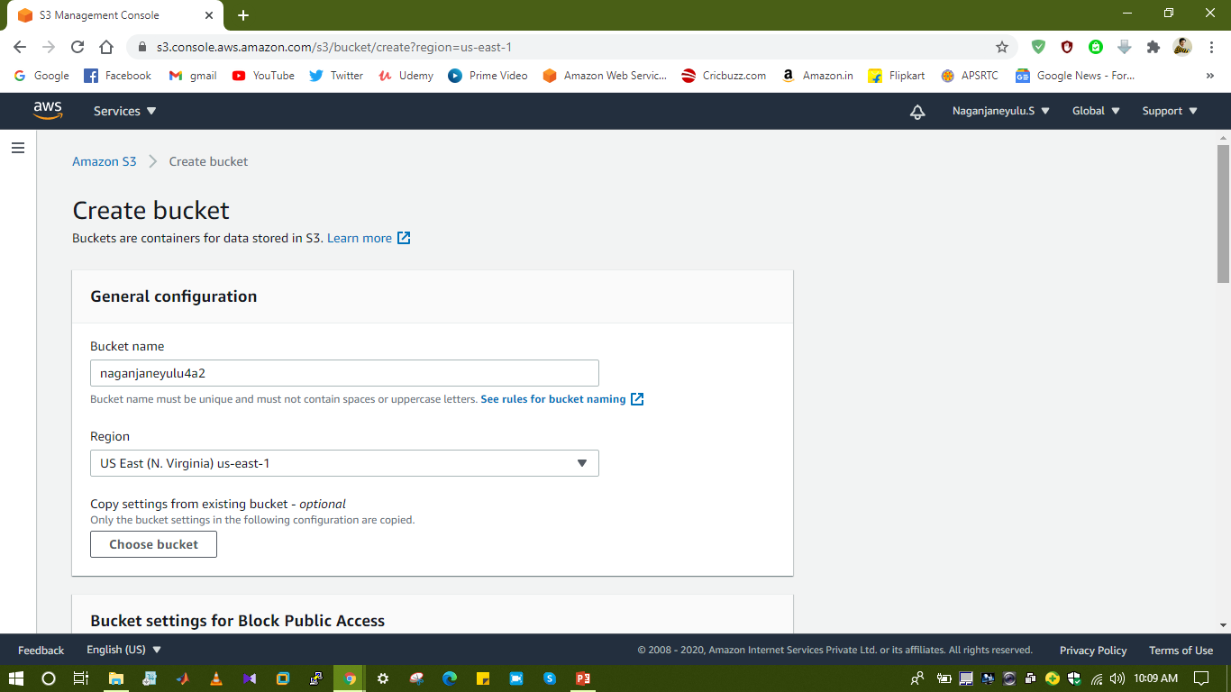
Bucket Details

Slide 5
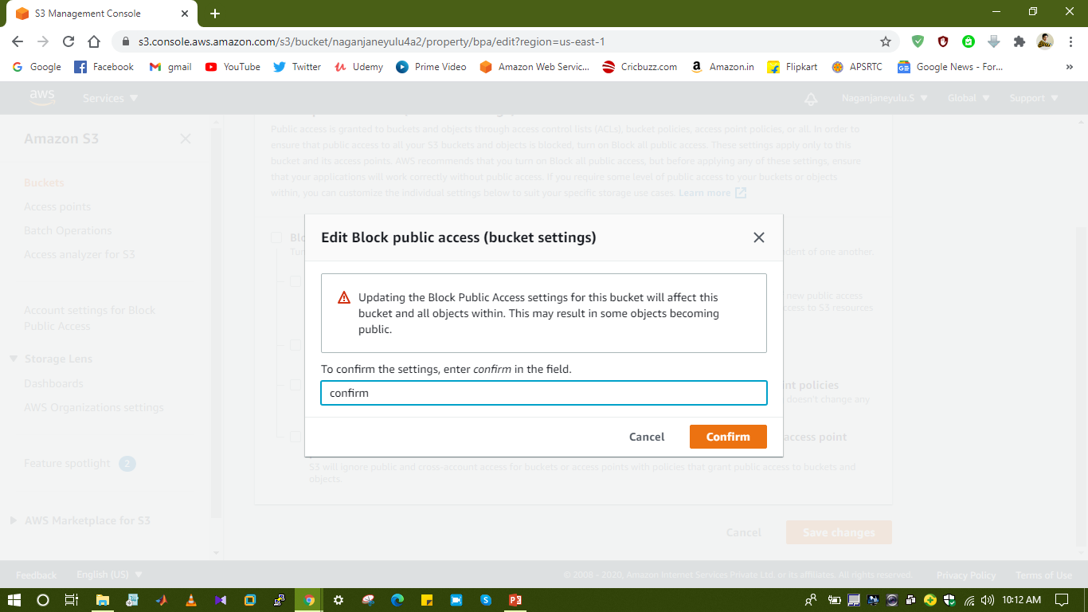
Make it Bucket as Public

Slide 6
Create Objects and Access to all
Open Bucket and upload objects.
For accessing the objects open Object URL.
By default objects are private, make it objects public then any one can access from internet, by using URL(Shown as picture below).

Slide 7
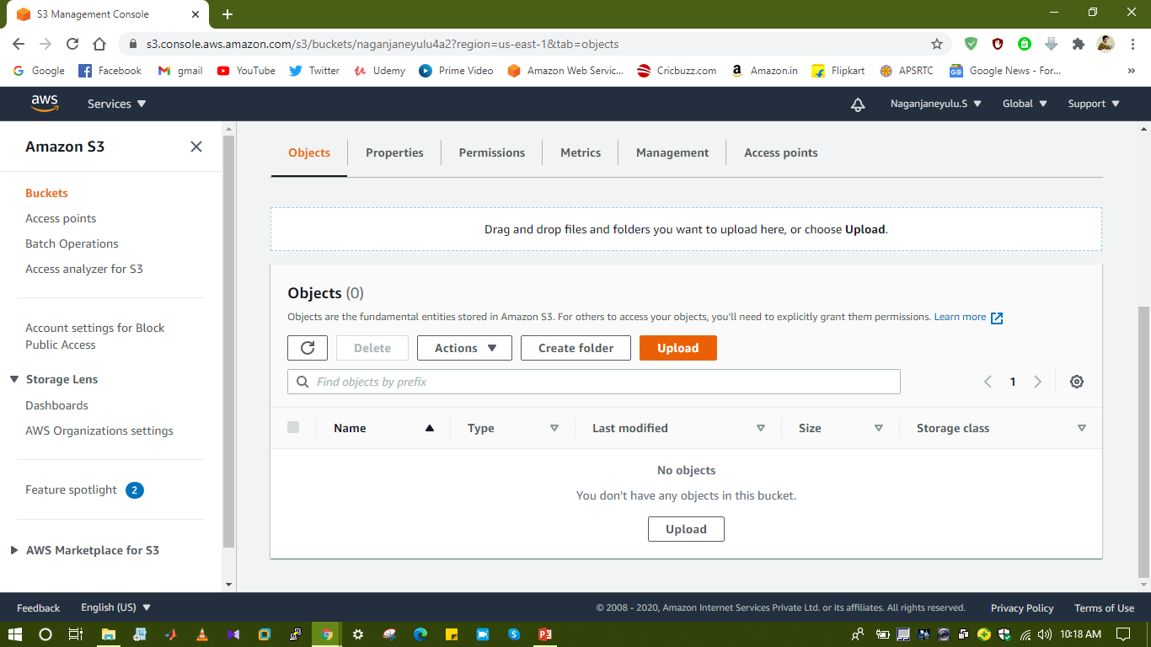

Slide 8
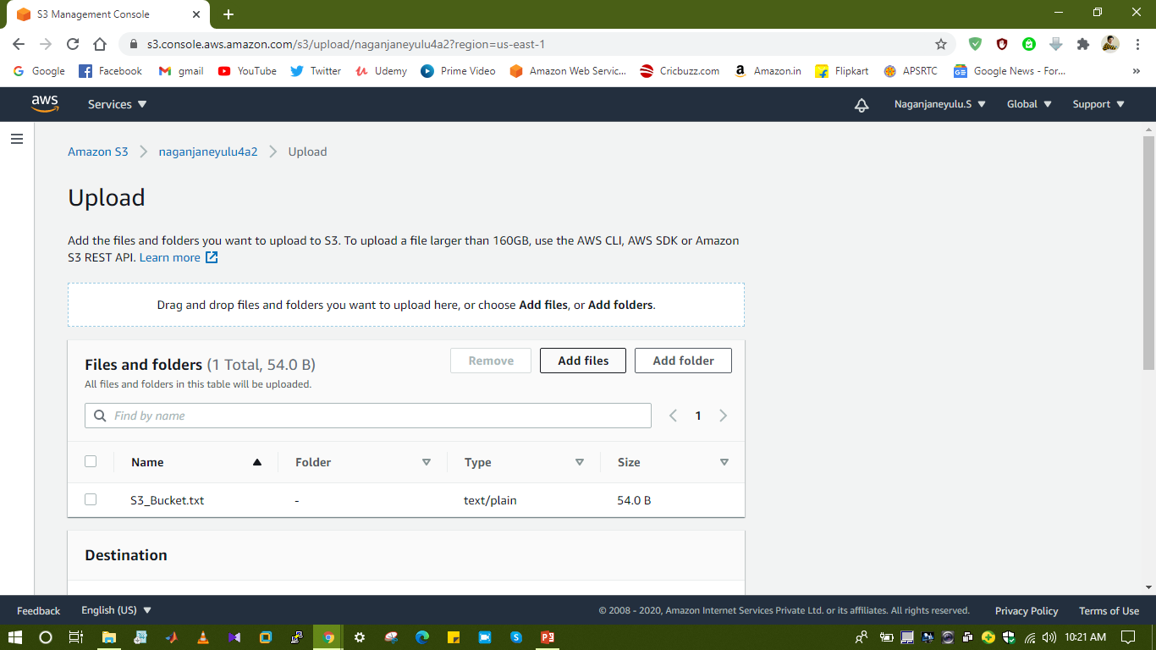
Upload objects

Slide 9
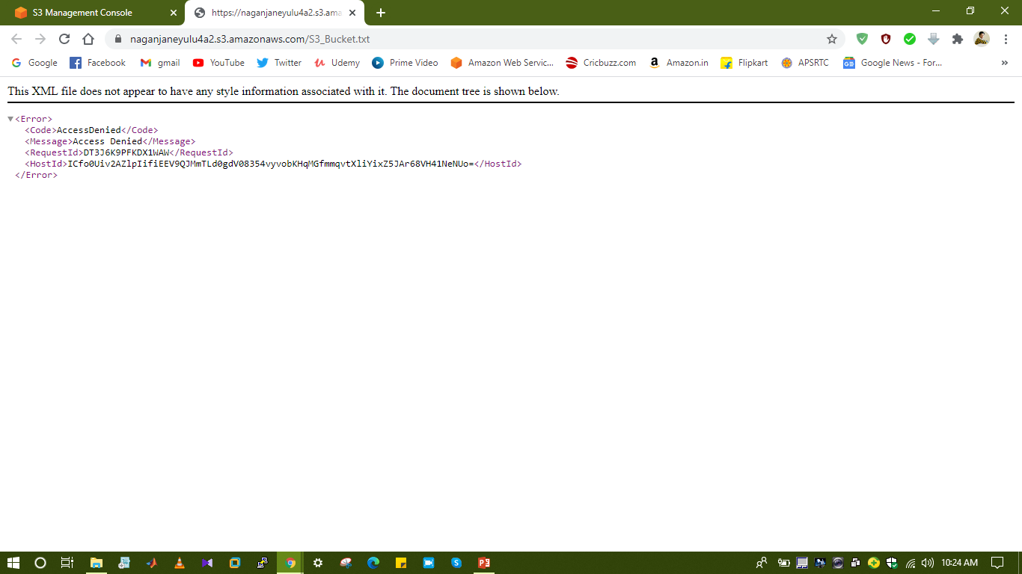

Slide 10
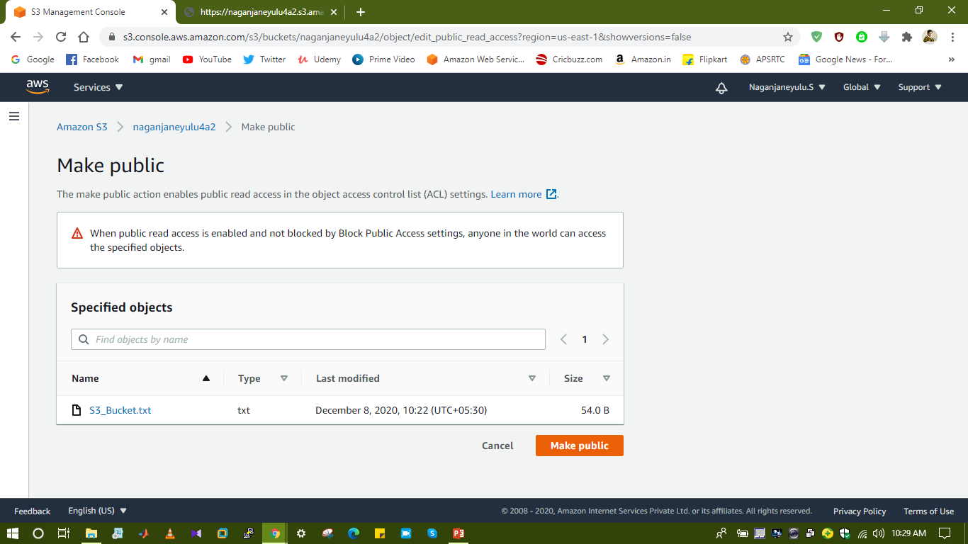

Slide 11
